Slide 1

Statistical Super Resolution for Data Analysis and Visualization of Large Scale Cosmological Simulations
Ko-Chih Wang¹, Jiayi Xu¹, Jonathan Woodring² and Han-Wei Shen¹
The Ohio State University¹ and Los Alamos National Laboratory²
Notes:
I am Ko-Chih Wang from the The Ohio state university
I am going to present a paper titled “Statistical super resolution for data analysis and visualizatin of large scale cosmological simulation”
The authors are Ko-Chih Wang, Jiayi Xu and Han-Wei Shen from The Ohio State University and Jonathan Woodring from Los alamos national laboratory
P1-P4: 4:30 mins
P5-P7: 2:mins
P8-P10: 3:30 mins
P14-P20: 4mins

Slide 2
Background
Nyx is a cosmological simulation developed by Lawrence Berkeley National Lab.
Link observed matter's distribution and evolution to fundamental physical parameters
Notes:
Nyx is a cosmological simulation developed by comologists in Laurence Berkeley laboratory.
(c ) The purpose of cosmological simulation is to try to link the observed distribution and evolution of matter in the universe with fundamental physical parameters.
because, some of these parameters serve as initial conditions for the universe.
For example, cosmologists can run the simulation with different parameters to find the set of parameters whose results are close to the observation to reduce the range of parameter for the future study.

Slide 3
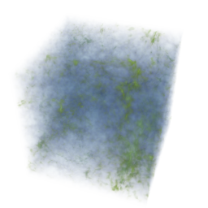

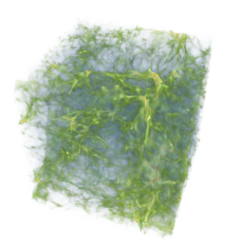
Background
Nyx is a cosmological simulation developed by Lawrence Berkeley National Lab.
Link observed matter's distribution and evolution to fundamental physical parameters
Lead to new insights of the governing physical model
The ensemble dataset generated by Nyx simulation
parameter1
parameter2
Simulator
Notes:
In addition, exploratory analysis of the simulation may lead to new insights of the governing physical model.
For example, comologists can study the nuanced behavior or universe evolution among simulation runs of different initial conditions.
(c ) All of these studied based on an ensemble dataset which is generate by Nyx simulation.
(c )The following figure illustrates the concept of ensemble dataset. In the example, the simulation can take 2 parameters and each parameter can have 6 possible values. So, the parameter space have 6*6 =36 possible initial conditions and each initial condition is a grid in this figure.
Each initial condition can be used to have a simulation run. The dataset from the simulation runs shows the universe evolution of the corresponding initial condition.

Slide 4

Motivation
Data size of an ensemble dataset: $P^{d}∗T∗Q∗S$
Nyx can produce several hundreds TBs to several PBs dataset
Limited I/O bandwidth
Insufficient storage size
Spatial resolution
Variables
Time steps
Simulation initial conditions
Notes:
Usually, the size of an ensemble dataset are very huge. This is the data size of an ensemble dataset.
(c )S here is the spatial resolution, (c )Q is the number of variable or quantities, (c ):T is the number of sampled time step, (c ) P is the number of input parameters for the simulation and D is the number of possible values on each parameter. So, p power of d is the total possible initial conditions.
(c ) Therefore, Nyx can simply produce the ensemble dataset in several hundereds TBs to several PBs size scale.
To handle such large-scale dataset for data analayis is very challengeing.
Although the computational power of the modern supercomputer is fast growing,
(c )the I/O bandwidth does not grow at the same pace. So, it will spend long time to write the data to disk and waste the supercomputer time. Besides, we may not have sufficient storage to keep such large ensemble dataset for analysis.
Although there is several simple approaches to handle the data, but they have shortcuts.

Slide 5
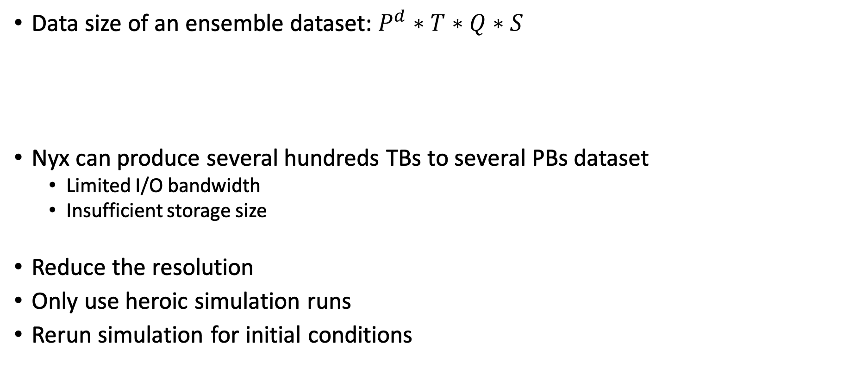
Motivation
Data size of an ensemble dataset: $P^{d}∗T∗Q∗S$
Nyx can produce several hundreds TBs to several PBs dataset
Limited I/O bandwidth
Insufficient storage size
Reduce the resolution
Only use heroic simulation runs
Rerun simulation for initial conditions
Spatial resolution
Variables
Time steps
Simulation initial conditions
Notes:
For example, the details may be lost if the spatial or temporal resolution is reduced in memory.
(c )The cosmological model exhibit a highly nonlinear response to the initial perturbations imposed at high redshift, in which case isolated ‘heroic’ simulation runs may not capture all of the features of interest which arise from such nonlinear behavior
(c ) Rerunning any simulation run when expert needs it and does not keep it for long time is a simple solution. But the simulation is computational expensive this may waste huge amount costly supercomputer time.
So, it is important to develop effective technique to handle the comological dataset to facilitate the data analysis tasks.

Slide 6
Our Contributions
Propose an in-situ and statistical-based approach to handle large-scale cosmological ensemble dataset
Reduce the requirements of the I/O bandwidth and disk storage
Integrate the proposed technique with Nyx simulation
Process the data without moving the data to disk
Provide high-quality reconstructed data for domain expert’s analysis tasks
Utilize the data coherence in the parameter space
Notes:
In this paper, we propose an in-situ and statistical-based approach to handle large-scale cosmological ensemble dataset.
We integrate our approach with nyx simulation code to process the data immediately after it is produced by the simulation to reduce the requirements of the I/O bandwidth and the disk storage.
Our technique utilizes the data coherence in the parameter space to provide high-quality reconstructed data for domain expert to analyze.

Slide 7
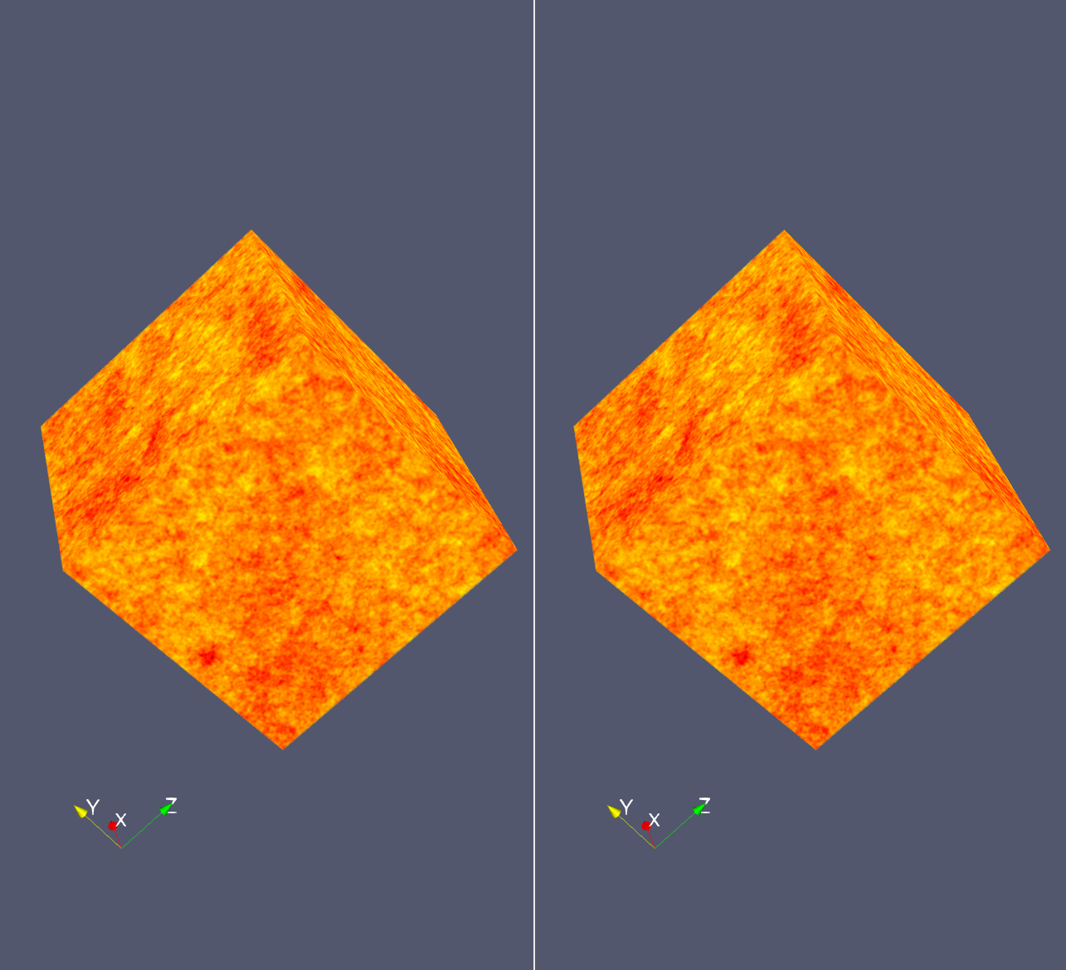
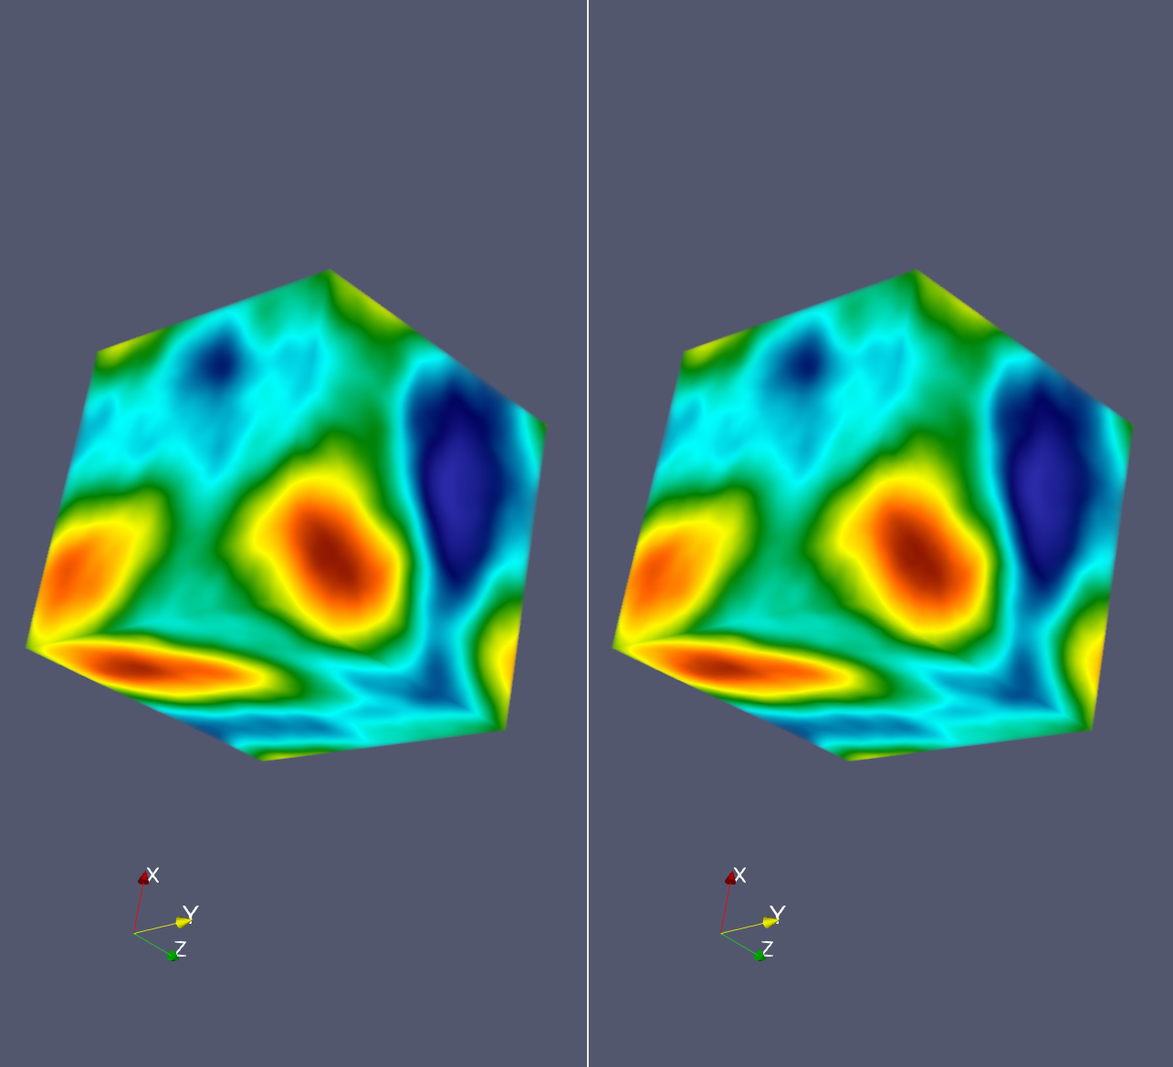
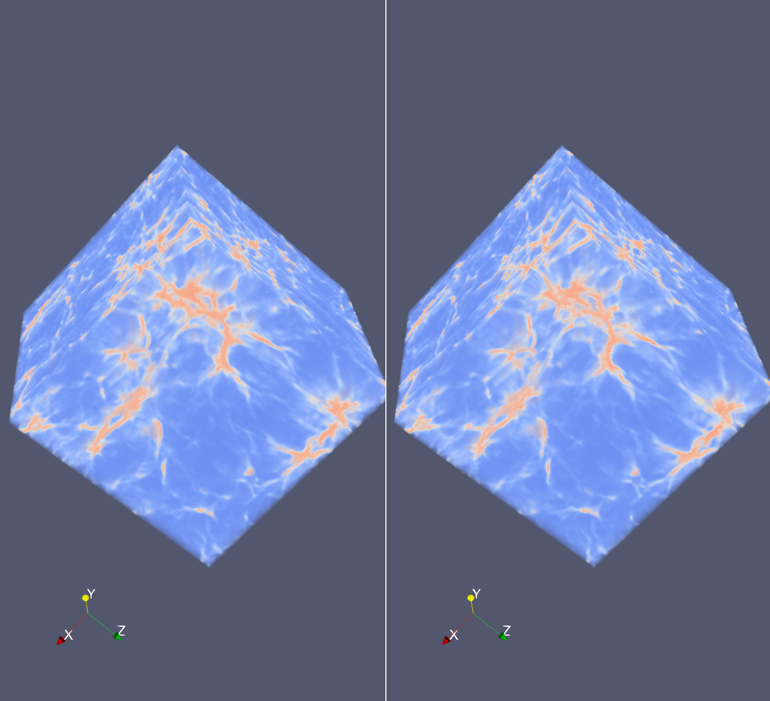
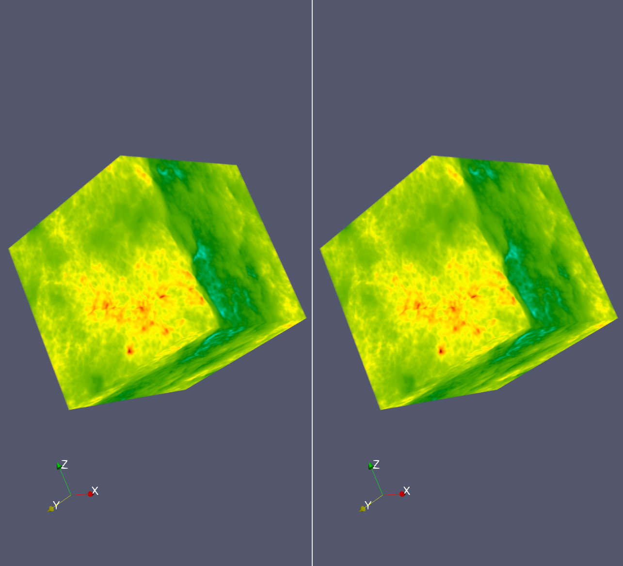
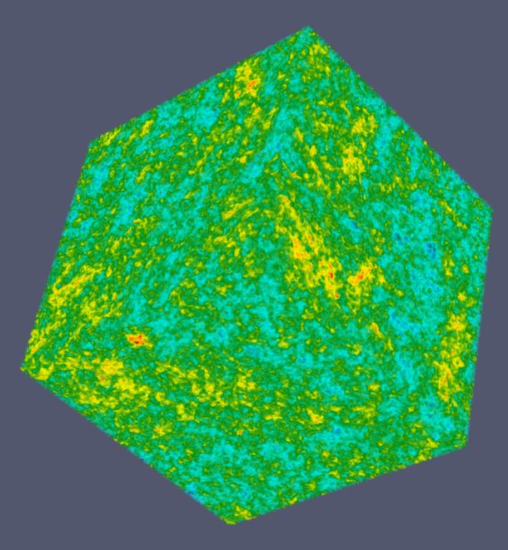
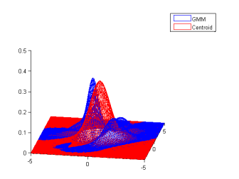
Overview
Supercomputer
Full resolution data
Post-Analysis
Disk
Prior knowledge
(map low to high resolution)
parameter1
Initial conditions
for prior knowledge
parameter2
Nyx
Simulation
In-situ statistical
down-sampling
Rest of the
initial conditions
Data Reconstruction
Notes:
This is the system overview and workflow of our technique.
The left most grids are the exampled parameter space which consists of two parameters. Each grid is an initial condition for Nyx cosmological simulation.
(c ) In our framework, a few initial condition which is colored by green is used to run the simulation and output full resolution results to disk. These results will be used to create a prior knowledge. The main purpose of the prior knowledge is to map data proxy from low resolution to high resolution and reconstruct the data.
(c ) And, When running the rest of the initial conditions in the parameter space, which are colored by pink, the data is directly down-sampled in the supercomputer. We only output the compact data proxy to disk to reduce the I/O time and storage requirement.
(c ) When cosmologists want to analyze the data, the prior knowledge and data proxy of an initial condition are loaded from disk and combined to reconstruct the original resolution data.

Slide 8
In-Situ Statistical Down-sampling
Supercomputer
Full resolution data
Post-Analysis
Disk
Prior knowledge
(map low to high resolution)
parameter1
Initial conditions
for prior knowledge
parameter2
Nyx
Simulation
In-situ statistical
down-sampling
Rest of the
initial conditions
Data Reconstruction
Notes:
We first introduce the in-situ statistical down-sampling which reduces the data for most of the simulation runs

Slide 9
In-Situ Statistical Down-sampling
Statistical down-sampling
Samples in each spatial sub-block is summarized by a Gaussian Mixture Model (GMM)
In-situ: data produced by the simulation is immediately processed in the supercomputer
Only the compact statistical down-sampled data is stored in disk
Handle data from more simulation runs
Supercomputer
parameter1
Disk
parameter2
Nyx
Cosmological Simulation
Statistical
down-sampled data
I/O
Notes:
To reduce the data size, we down-sampled the data from each simulation run. The data is sub-divided into subblocks and data samples in each sub-block is summarized by a univariate Gaussian mixture model which can preserve the statistically properties of a sub-block.
(c ) We plug this data process into the Nyx cosmological simulation to run it with the simulation in the supercomputer.
When the simulation generates the data of a time step, our program immediately take the data and process the data in situ and model the data by Gaussian mixture models.
(c )Only the statistical down-sampled data is outputted to disk.
By this way, we can keep data from more simulation runs in the disk for analysis

Slide 10
Prior Knowledge
Supercomputer
Full resolution data
Post-Analysis
Disk
Prior knowledge
(map low to high resolution)
parameter1
Initial conditions
for prior knowledge
parameter2
Nyx
Simulation
In-situ statistical
down-sampling
Rest of the
initial conditions
Data Reconstruction
Notes:
Then, I will intoduce the prior knowledge which helps to recover the statistical down-sampled data to the original resolution

Slide 11
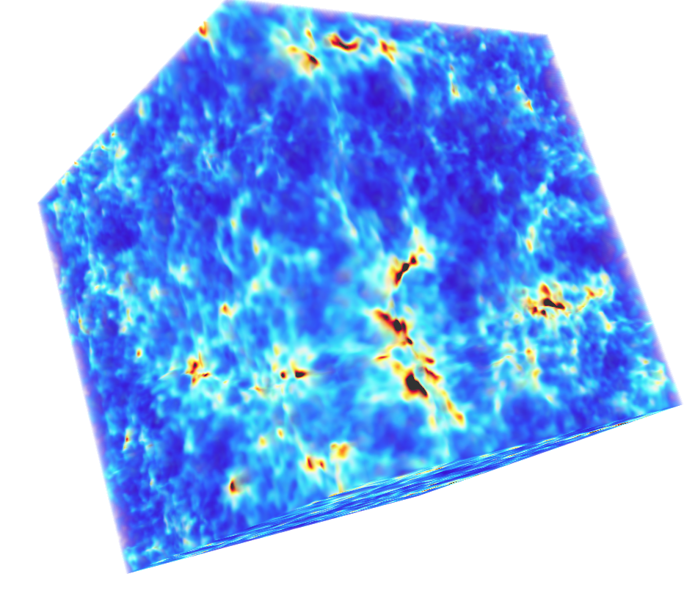
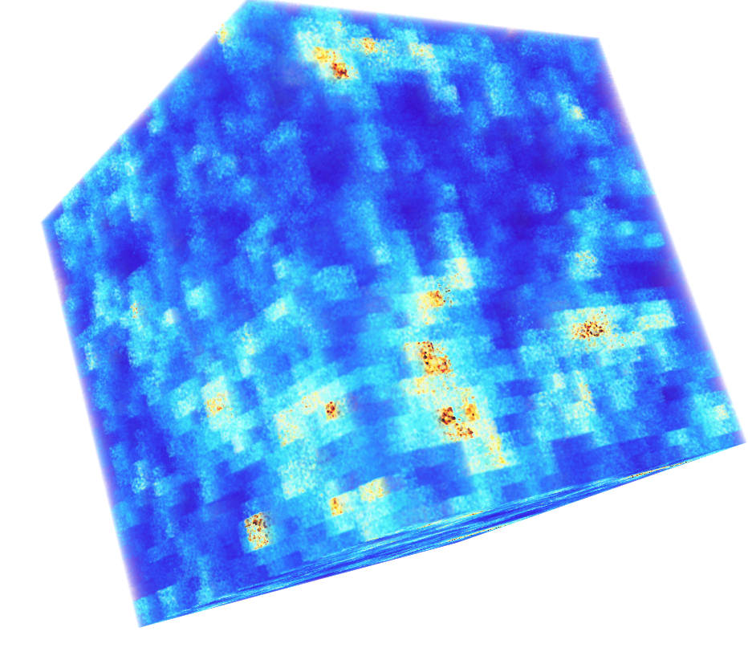
Prior Knowledge
Data reconstructed from statistical down-sampled data
Incorrect feature shapes
Lack of the samples’ location information
Raw Data
Monte Carlo Resampling
Notes:
If we reconstruct the statistical down-sampled data to original resolution without any additional information, the common approach is to use monte carlo sampling to resample data from a GMM of the corresponding sub-block.
However, GMM does not preserve the samples' location information, the resampled data can only randomly place in the sub-block space.
The left image is rendered from the raw data and the right image is the reconstruction from the statistical down-sampled data by Monte-carlo sampling. We can see that the feature shape are not preserved well.

Slide 12
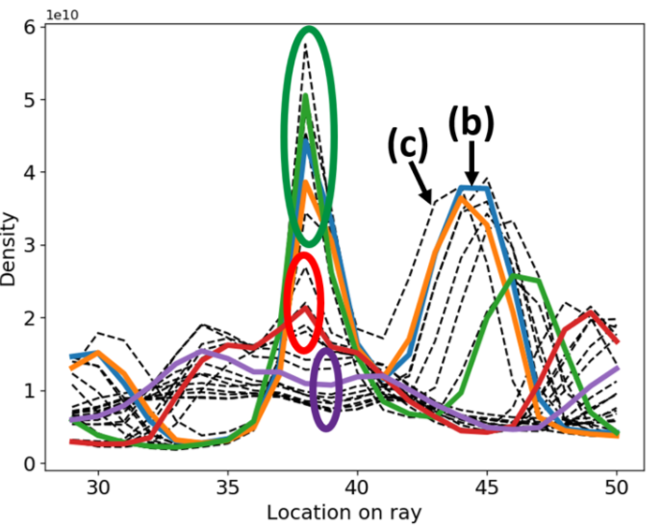
Prior Knowledge
Data reconstructed from statistical down-sampled data
Incorrect feature shapes
Lack of the samples’ location information
Prior knowledge
Utilize the data coherence in the parameter space
Reconstruct data of a sub-block represented by a GMM
Ç
Ç
Ç
Raw Data
Monte Carlo Resampling
Notes:
Prior knowledge is the data collected from a few simulation runs.
The right most figure is an example from a few simulation runs. We use this figure as an example to illustrate the idea of prior knowledge.
Curve are data values along the same ray of different simulation runs. X-axis is location on the ray and y is dark matter density on the ray.
We can observe that although each simulation runs are different, but the local pattern could be categorized into several groups and the local pattern in each group are similar.
For example, density values from multiple simulation runs highlighted by green circle has a similar local pattern…it is a peak there.
Or we can observe that density from multiple simulation runs highlighted by purple circle has the other type of local pattern , it is a small cave there…
So, this data coherence among different simulation runs has the potential to accurately recover the down-sampling data to original resolution

Slide 13
Prior Knowledge Data
Data collection for prior knowledge
Small number of simulation runs for prior knowledge
Simulation parameter space
Notes:
The prior knowledge should provide the local pattern to help to reconstruct the data.
So, we output full resolution data from several initial conditions for use later.
and, we would like to just select a small number of initial conditions to run the simulation for prior knowledge to prevent from outputting huge amount of full resolution data.
In order to maximize the data variation in prior knowledge and avoid to pick up the initial conditions which generate too similar data,

Slide 14
Prior Knowledge Data
Data collection for prior knowledge
Small number of simulation runs for prior knowledge
Latin hypercube sampling in the parameter space
Collect data with as higher as possible variation
8 queens problem
Simulation parameter space
Sampled parameter input
Latin hypercube sampling
Nyx simulation
Full resolution data to disk
Notes:
we use latin hypercube sampling to sample the initial conditions in the parameter space.
Latin hyper cube is a sampling approach which is also used by cosmologist to have small number of simulation runs , but have as high as possible data variation the data in the parameter space.
This figure is a 2 parameters example, latin hyper cube sampling is similar to 8 queens problem. A sampled grid and any other sampled girds does not have same column and row id.
The green grids are the sampled initial conditions, they will be sent to the nyx simulation and output full resolution data for prior knowledge.

Slide 15
Data Reconstruction
Supercomputer
Full resolution data
Post-Analysis
Disk
Prior knowledge
(map low to high resolution)
parameter1
Initial conditions
for prior knowledge
parameter2
Nyx
Simulation
In-situ statistical
down-sampling
Rest of the
initial conditions
Data Reconstruction
Notes:
After we have the statistical down-sampled data and prior knowledge.
We can combine them to recover the original resolution data.

Slide 16
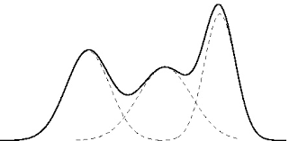



Prior Knowledge Search
To compensate for the lack of spatial information of a sub-block $G$ represented by a GMM
Find a $P$ which has similar local pattern to $G$
$$G$$
$$P$$
Statistical down-sampled data
Prior knowledge data
Notes:
The main purpose of the prior knowledge is to tell us how to place the resampled data from GMM to space.
To reconstruct a sub-block G which is represented by a GMM, we have to predict a same size sub-block P in the prior knowledge data which could have similar local pattern with original sub-block of G.

Slide 17
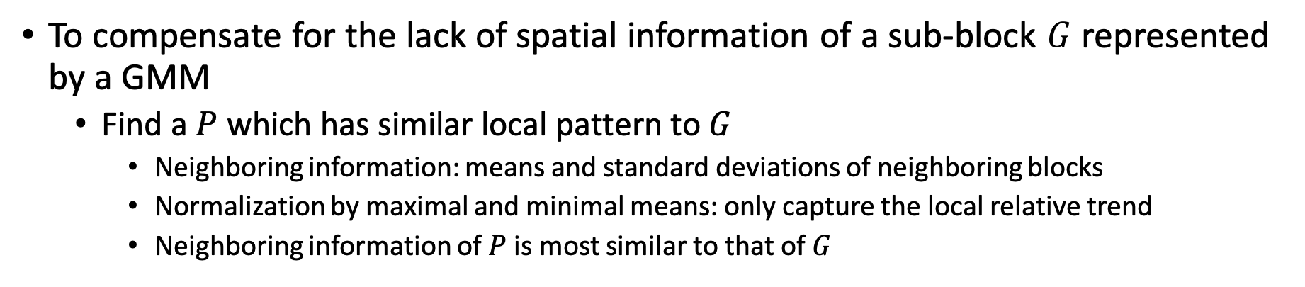
Prior Knowledge Search
To compensate for the lack of spatial information of a sub-block $G$ represented by a GMM
Find a $P$ which has similar local pattern to $G$
Neighboring information: means and standard deviations of neighboring blocks
Normalization by maximal and minimal means: only capture the local relative trend
Neighboring information of $P$ is most similar to that of $G$
μ₀ 𝛔₀ | μ₁ 𝛔₁ | μ₂ 𝛔₂
μ₃ 𝛔₃ | μ₄ 𝛔₄ | μ₅ 𝛔₅
μ₆ 𝛔₆ | μ₇ 𝛔₇ | μ₈ 𝛔₈
μ₀ 𝛔₀ | μ₁ 𝛔₁ | μ₂ 𝛔₂
μ₃ 𝛔₃ | μ₄ 𝛔₄ | μ₅ 𝛔₅
μ₆ 𝛔₆ | μ₇ 𝛔₇ | μ₈ 𝛔₈
$$G$$
Similarity
$$P$$
Statistical down-sampled data
Prior knowledge data
Notes:
To search the P in prior knowledge, we use the statistical values, such as mean and standard deviation, from the local neighboring block of G to create a feature map.
(c )For any candidate sub-blocks in prior knowledge, we can use the same way to create a feature map.
(c )In addition, the feature mapis normalized by the maximal and minimal mean value of the feature map, because we only want to capture the local relative trend and ignore the absolute value.
(c )A sub-block P in the prior knowledge whose feature map is most similar to G’s feature map will be used to reconstruct G to original resolution

Slide 18
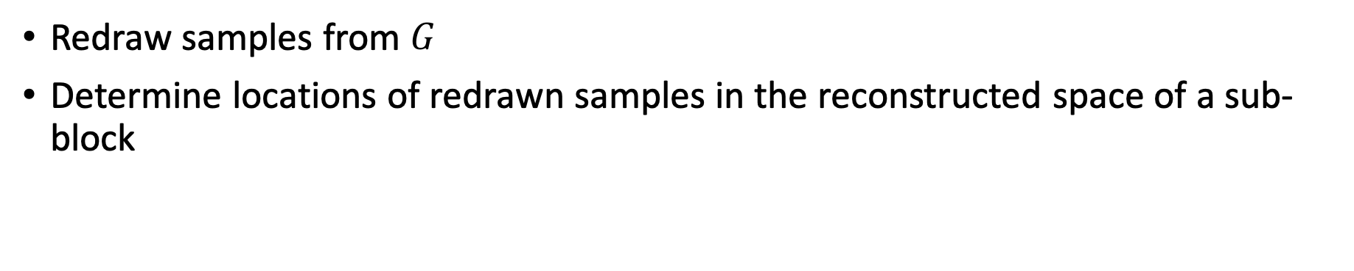
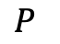
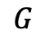
Reconstruction
Redraw samples from $G^{}$
Determine locations of redrawn samples in the reconstructed space of a sub-block
$$G$$
Prob.
$$P$$
data value
GMM of
a sub-block
Notes:
After we have the selected P from the prori knowledge, we can combine P and G to reconstruct the sub-block which is represented by G.
Here has two main steps, one is redrawn sample from the GMM which present the sub-block G
The other one is to determine locations of redrawn samples in the reconstructed space of a sub-block
Our goal here is to make the relative local pattern of the reconstructed sub-block is as similar as possible to that of P
We use the following animation to illustrate a sub-block reconstruction by given its GMM and a P( prior knowledge)

Slide 19
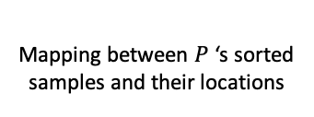
Reconstruction
Redraw samples from $G^{}$
Determine locations of redrawn samples in the reconstructed space of a sub-block
Mapping
(rank by value)
Mapping between $P$‘s sorted samples and their locations
$$G$$
Prob.
Resampling
Sorting
Reconstructed space
$$P$$
data value
GMM of
a sub-block
Notes:
We first draw samples from the GMM. The sample count is the number of grind points of the sub-block.
(C ) We sort the drawn samples by their values. Here the color intensity indicates the samples value.
(C ) Then, we also sorted all samples in P by the sample values and each sample still keep its original location in P .
(C ) the sorted samples from GMM and sorted sampled from P create a 1 on 1 mapping by their rank by value in each group.
(C ) Each drawn sample from GMM will be assign to the where its corresponding sample in P comes from. After this procedure, the relative value change of the reconstructed sub-block will be similar to P.

Slide 20
Evaluation
Dataset
Parameter space: 3 parameters and 10 samples on each parameter (10³ initial conditions)
Variables: 7
Spatial resolution: 256³
Temporal resolution: 200
Size: 85 TB
Notes:
We will show the effectivity of our approach on the nyx cosmolocal ensemble dataset.
In the test scenario, the parameter space consists of three parameters [hubble constant, baryon density parameter, total matter density parameter], each paramter can have 10 possible values. So, the parameter space can have 1000 initial condition and produce 1000 ensemble members.
Nyx generate 7 variables (quanties) which are …..[dark matter particles, X-momentum,Y-momentum, Z-momentum, internal energy of the gas, temperatureand gravitational potential]
The resolution of each volume here is 256 cube and the temporal resolution is 200 time steps.
If we store the raw data, it requires 85 TB storage space.

Slide 21
Evaluation
Dataset
Parameter space: 3 parameters and 10 samples on each parameter (10³ initial conditions)
Variables: 7
Spatial resolution: 256³
Temporal resolution: 200
Size: 85 TB
Data Proxy
Prior knowledge: 0.024 TB (5 initial conditions)
Down-sampling: 0.36 TB
Each 16³ is modeled by a GMM with 5 Gaussians
Size: 0.384 TB (0.44%)
Notes:
By using our technique to handle the dataset,
We use 5 initial conditions to generate the prior knowledge data, which cost 24 GB.
The data from the rest of initial conditions are in situ statistically down-sampled.
We use a subblock size 16 cube to subdive each volume and each sub-block is modeled by a Gaussian mixture model with 5 Gaussian component.
The total statistical down-sampled data costs 360GBs.
Our data proxy output 384GBs to disk in total and it cost 0.44% of the raw data size.

Slide 22
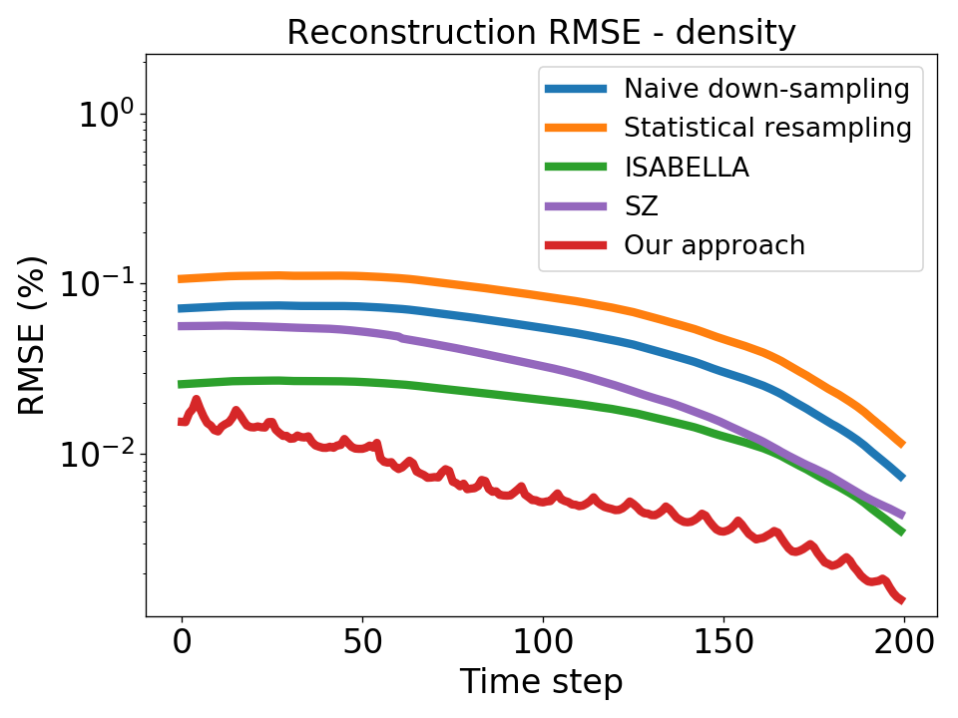
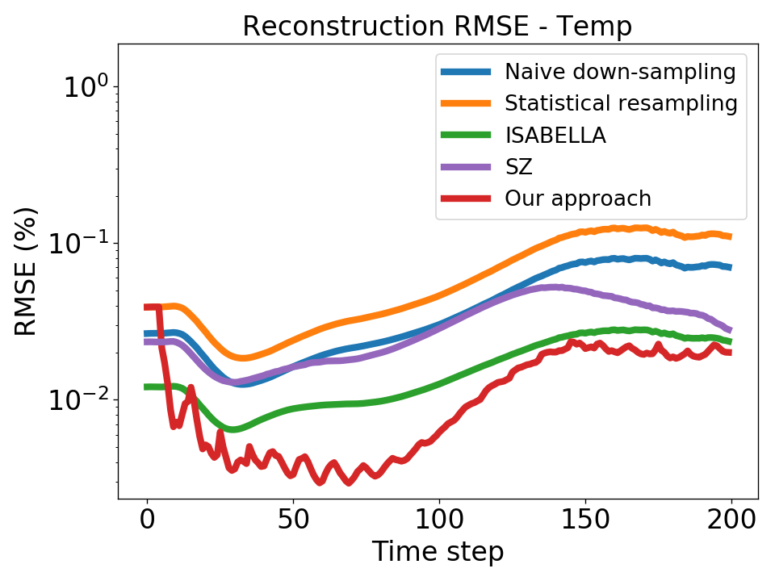
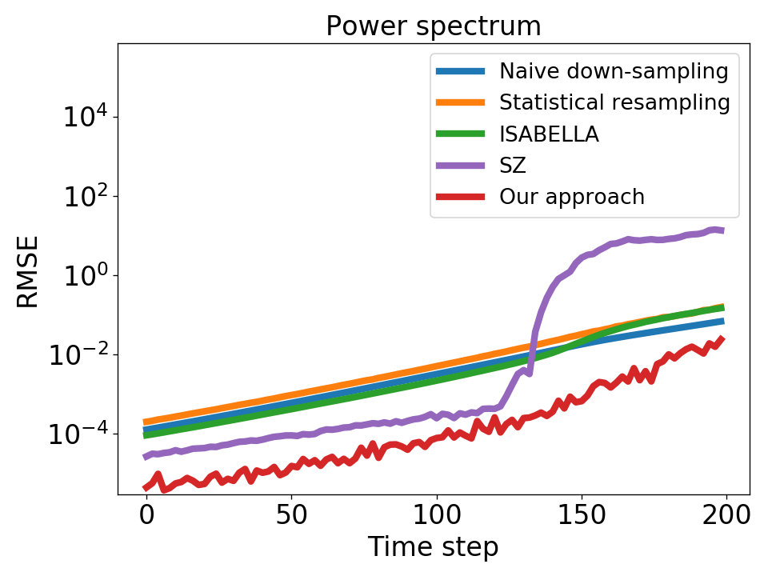
Quantitative Evaluation
Notes:
In our evaluation, we compare data from our approach with reconstructed data native-down sampling, statistcal down-sampling only, ISABELA lossy compression and SZ lossy compression.
We quantitative evaluate and compare the data reconstruction error on 7 quantities of all time steps and error of power spectrum which is caculated from the reconstructed data.
Power spectrum is cosmological attribute and widely used in cosmologists'' domain.
Here, we only show error plots of two quantities, dark matter density and temperature and power spectrum.
In each sub-figure, the x-axis is time steps and y-axis is the root mean square error, each curve is an approach.
Overall, we can observe that our approach has smaller error than other alternatives.

Slide 23
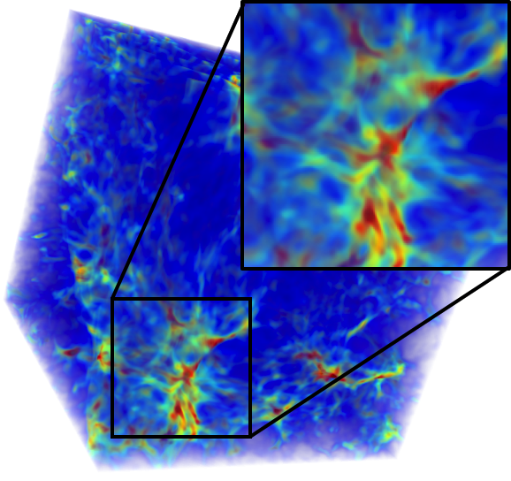
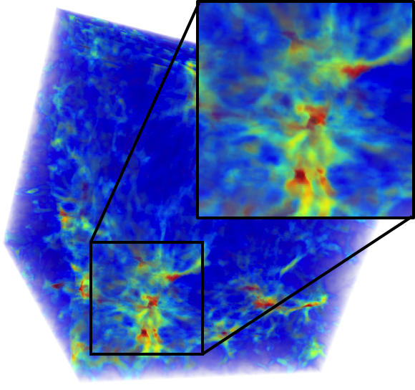
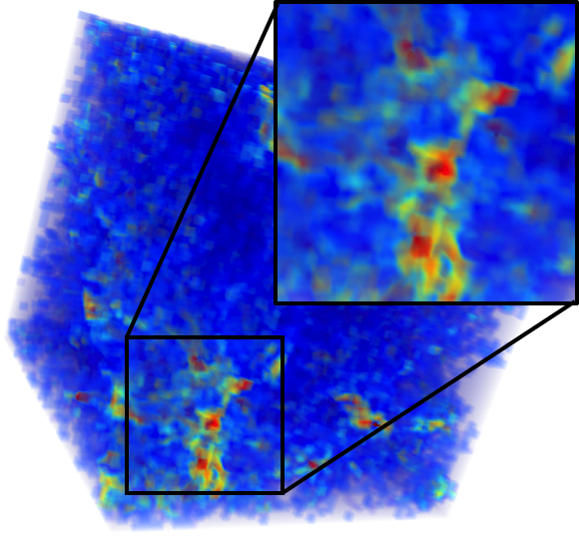
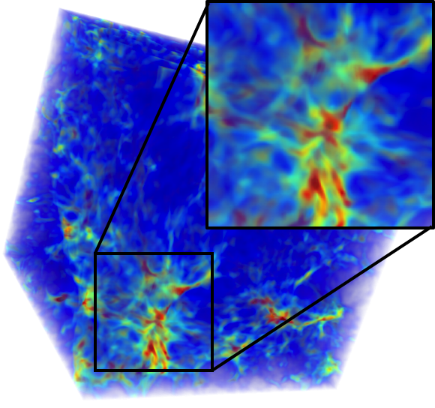
Qualitative Evaluation – Dark Matter Density
Raw (100%)
ISABELA (24%)
SZ (4.5%)
Ours (0.44%)
Notes:
We also qualitative evaluate our appraoch with ISABELA and SZ.
This is volume rendering from the dark matter density field at time step 200 of a specific initial condition.
The number in the parathesis is the storage cost compared to the raw data.
We can observe that our approach preserve more accurate color and feature shape than other two alternatives and use less storage size.

Slide 24
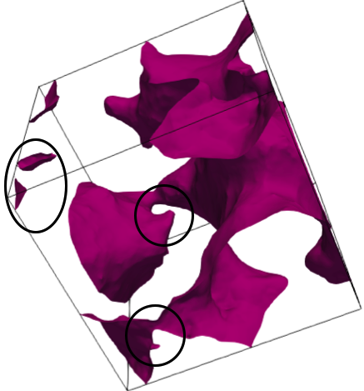
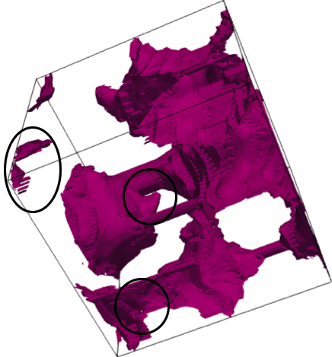
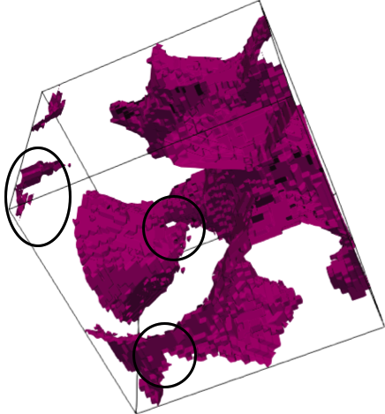

Qualitative Evaluation – Isosurface from Gravitational Potential
Raw (100%)
ISABELA (24%)
SZ (4.5%)
Ours (0.44%)
Notes:
This is the isosurface of an isovalue from gravitational potential
We highlight several regions and we can observe that our approach preserve more accurate isosurfaces.

Slide 25
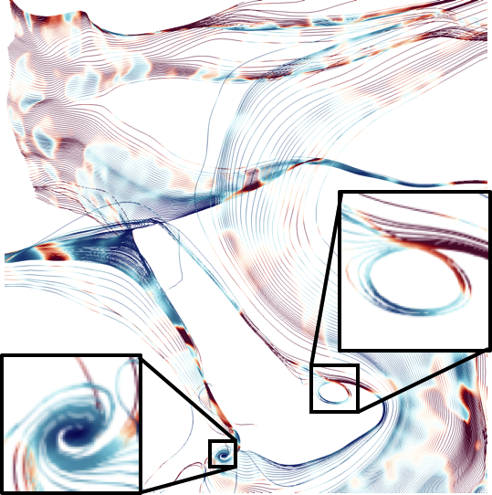
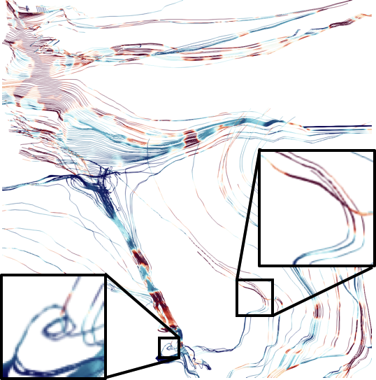
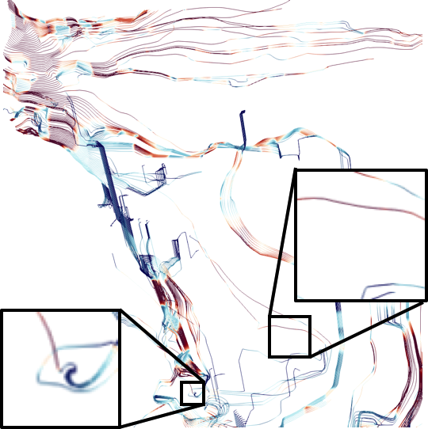
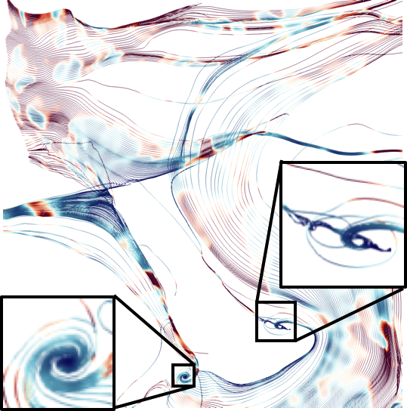
Qualitative Evaluation – Streamlines from Dark Matter Momentum
Raw (100%)
ISABELA (24%)
SZ (4.5%)
Ours (0.44%)
Notes:
This is streamline from the vector field consist of x- y- z- momentum of a zoom in area.
We can observe that there is a swirl and a vortex in the raw data.
Our approach well reproduce the left votex and also somewhat reprocude the right swirl.
But, the other two alterntatives cannot reproduce the swirl and the vortex even if they spend more storage size.

Slide 26
Conclusion
We present a statistical-based representation to handle large-scale cosmological ensemble dataset
Data is in-situ down-sampled and can be reconstructed to original resolution by using the data coherence in the parameter space
We qualitatively and quantitatively show the proposed approach has better trade off than other alternatives
Notes:
In this paper..............just read...

Slide 27
Thank you for listening!
Questions?
Acknowledgments
This work was supported in part by NSF grants IIS- 1250752, IIS- 1065025, and US Department of Energy grants DE- SC0007444, DEDC0012495. We also thank the domain scientists, Zarija Lukic, from Lawrence Berkeley National Laboratory to provide the insight of Nyx simulation and the feedback of our work.
Notes:
we greately acknoledge to the grants which supports this research
and
Thanks for your listening, I am welcome to take questions.

Slide 28
Backup slides

Slide 29
GMM detail and VTK-m (implement detail)
What is GMM and block to GMM
Integrate VTK-m...
Notes:
Details …subsample….to GMM

Slide 30


Super-resolution
Image super-resolution
Enhance the resolution of an image system
Using the prior knowledge from collected images
Prior knowledge from the training set
a mapping between low- and high-resolution image patches
Training Images
Prior Knowledge
Low res. feature | High res. patch
... | ...
... | ...
... | ...
Train
Super-Resolution
Algorithm
Low Resolution
Image
High Resolution
Image
Image courtesy of ‘’ https://amundtveit.com/2017/06/04/deep-learning-for-image-super-resolution-scale-up/”
Notes:
(probability remove this...)

Slide 31
Background
Nyx is a cosmological simulation developed by Lawrence Berkeley National Laboratory
Link observed matter's distribution and evolution to fundamental physical parameters
e.g. run simulation with different parameters to find "best matching" set of parameters that matches the observation
Explore and analyze simulation results may lead to new insights of the governing physical model
e.g. study the nuanced behavior when varying the initial conditions
These studies are based on the ensemble dataset generated by Nyx simulation
parameter1
parameter2
Simulator
Notes:
Nyx is a cosmological simulation developed by comologists in Laurence Berkeley laboratory.
(c ) The purpose of cosmological simulation is to try to link the observed distribution and evolution of matter in the universe with fundamental physical parameters.
because, some of these parameters serve as initial conditions for the universe.
For example, cosmologists can run the simulation with different parameters to find the set of parameters whose results are close to the observation to reduce the range of parameter for the future study.
(c ) In addition, exploratory analysis of the simulation may lead to new insights of the governing physical model.
For example, comologists can study the nuanced behavior or universe evolution among simulation runs of different initial conditions.
(c ) All of these studied based on an ensemble dataset which is generate by Nyx simulation.
The following figure illustrates the concept of ensemble dataset. In the example, the simulation can take 2 parameters and each parameter can have 6 possible values. So, the parameter space have 6*6 possible initial conditions and each initial condition is a grid in this figure.
Each initial condition can be used to have a simulation run. The dataset from the simulation runs shows the universe evolution of the corresponding initial condition.

Slide 32
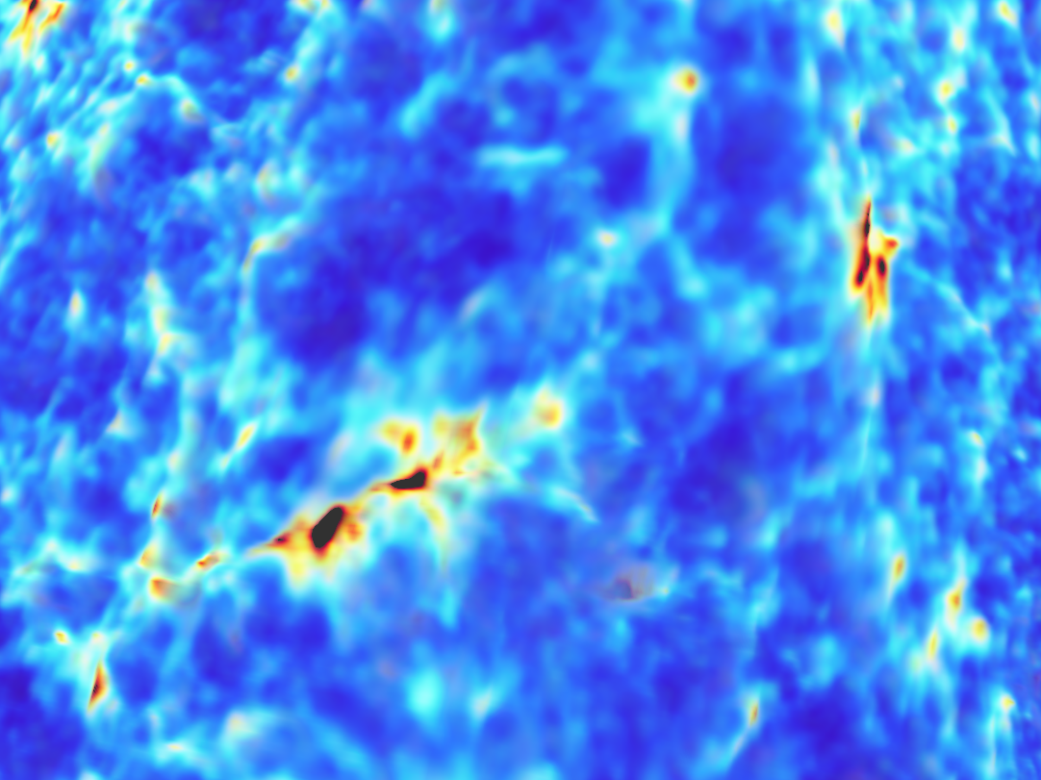
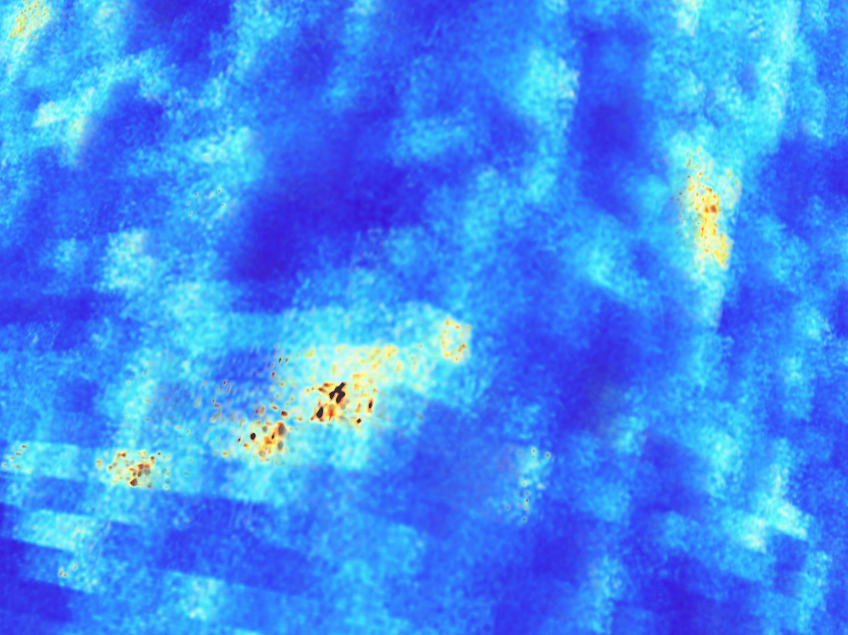

Slide 33
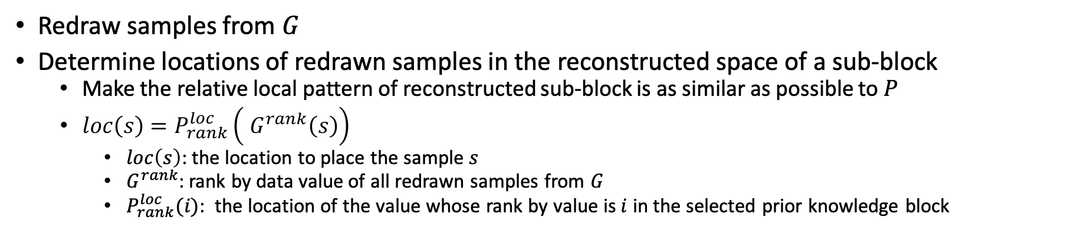
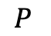
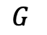
Reconstruction
Redraw samples from $G^{}$
Determine locations of redrawn samples in the reconstructed space of a sub-block
Make the relative local pattern of reconstructed sub-block is as similar as possible to $P$
$loc\left(s\right)=P_{rank}^{loc}\left( G^{rank}\left(s\right)\right)$
$loc\left(s\right)$: the location to place the sample $s$
$G^{rank}$: rank by data value of all redrawn samples from $G$
$P_{rank}^{loc}(i)$: the location of the value whose rank by value is $i$ in the selected prior knowledge block
$$P$$
$$G$$
Prob.
Resampling
Sorting
Assignment
Reconstructed space of
a sub-block
data value
GMM of
a sub-block
Notes:
After we have selected P in the prori knowledge, we can combine P and G to reconstruct the sub-block which is represented by G
Here has two main steps, one is redrawn sample from the GMM which present the sub-block G
The other one is to determine locations of redrawn samples in the reconstructed space of a sub-block
Our goal here is to make the relative local pattern of the reconstructed sub-block is as similar as possible to P
For any redrawn sample “s”, we search the location of the sample in P whose rank by value in P is equal to the rank by data value of the sample s in all redrawn samples, then place s at the location
(c )The following is a 2D example to reconstruct a 2x2 sub-block from a given GMM G and a selected P from prior knowledge.
(c )We first resample 2*2 4 samples from the GMM and (c )sort these sample to know the samples’ rank by value in all redarwn samples. Here, brighter circle indicate higher data value.
(c )Then, we can first pick the sample whose rank by value is 1 which mean it has largest value among the redrawn smaples, (c )and find the location in P where the rank by value is also 1 (c )and place the sample to the same location in the sub-block.
(c )Then, we pick the sample whose rank by value is 2, (c )and find the location in P where the rank by value is also 2 (c )and place the sample to the same location.
(c cccccc) the algorithm just follow this to assign all samples to the the sub-block space to reconstruct the data.

